Slide 1
Ground Control Station Overview

Slide 2
Overview
Overview
Control Interface
Communications
Power System
Tranportability

Slide 3
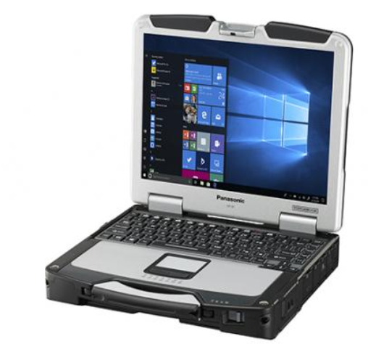
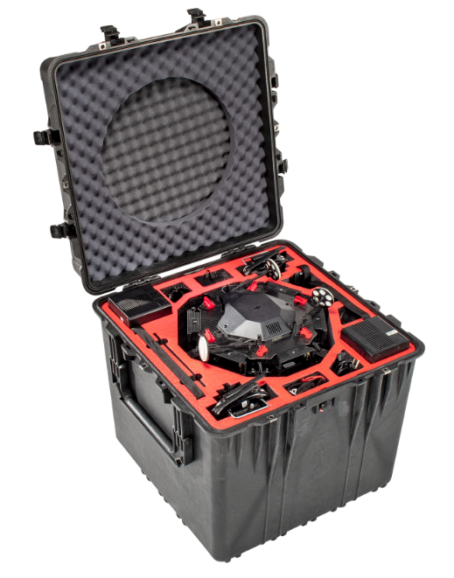

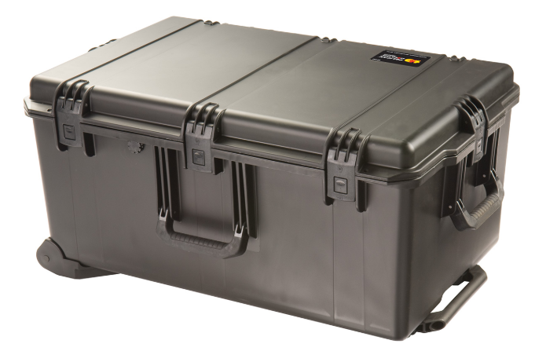
Overview
COTS Rugged Computer
Vehicle Transit Case
COTS Controller
Control Transit Case
Storage for Computer
Integrated Radios
Additional Processing and Storage
Power Distribution Unit
https://www.pelican.com/us/en/product/cases/dji-matrice-600-pro-drone-case/flightline/fltdm600
https://na.panasonic.com/us/computers-tablets-handhelds/computers/laptops/toughbook-31

Slide 4
Control Interface
Control Interface is 100% Commercial-Off-The-Shelf
Panasonic Toughbook + Xbox One
Leverages extensive industry base
Easy replacement
Reduced training
Computer
Model | Panasonic Toughbook 31
Size | 13.1 in class
Processor | Intel i7
Storage | 512 Gb Solid State
RAM | 32 GB
Operating System | Red Hat Enterprise Linux
Controller
Model | Xbox One Controller

Slide 5
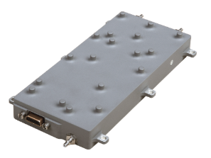
Communications
Integrated Radios
UHF Band Control Link
Ku / L band payload link
Can support multiple antenna options
Man portable (included in transit case)
Vehicle mounted (connect through auxiliary cables)
Power Distribution Unit
Powers all GCS equipment
Includes battery with 10 hour battery life
External power connections for 115 VAC and 12 VDC
Additional Processing
Image processing capability for stitching wide area images
Auxiliary image/video storage
Control Radio
Model | Atlas Inc XR Datalink
Payload Radio
Model | Z4 Technologies Multi-band Datalink
Processor
Weight | 40 lb (with laptop)
Processor | Quad Core Intel Processor
Storage | 10 TB Solid State
RAM | 32 GB

Slide 6
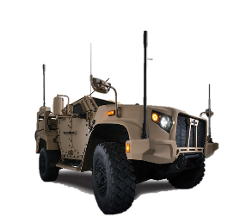
Transportability
All Nomad equipment (including vehicle) is transportable in two transit cases
Designed to be unloaded and operational within 10 minutes by a single operator
<100 lb total weight

